Slide 1
OEE Box
Yaser Ali Husen

Slide 2
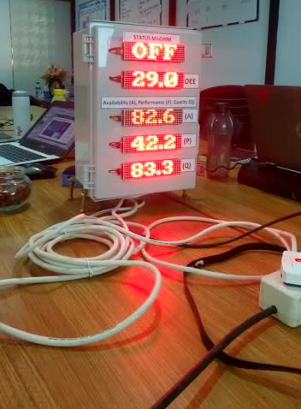
Purpose & Goal
Providing OEE Monitoring System With Low Cost Budget
Easy to build the system
Easy to use and develop
OEE Box

Slide 3
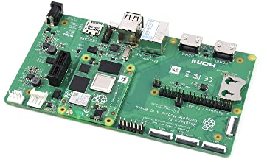
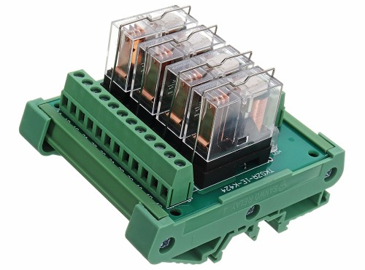
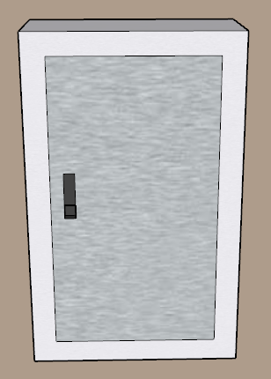
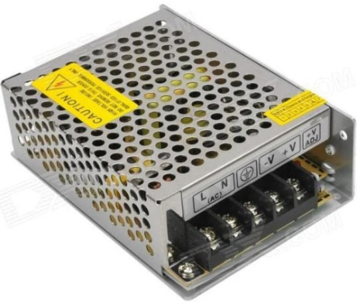
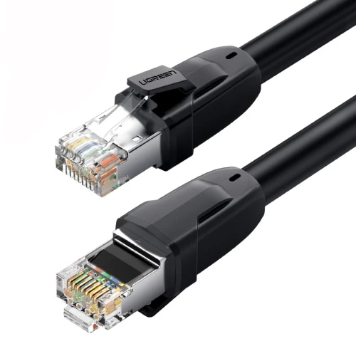
OEE Box
Raspberry PI Compute Module 4 as IoT Device
Relays, for receiving signal from machine
Power Supply 12 V
Using Ethernet cable for communication to database

Slide 4
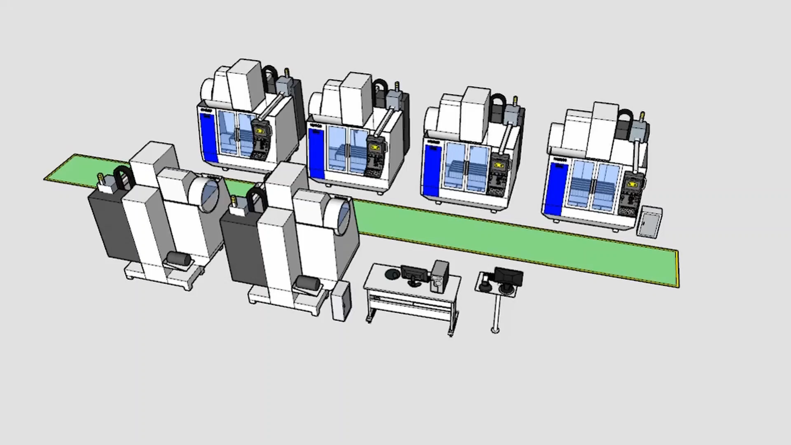
Concept

Slide 5
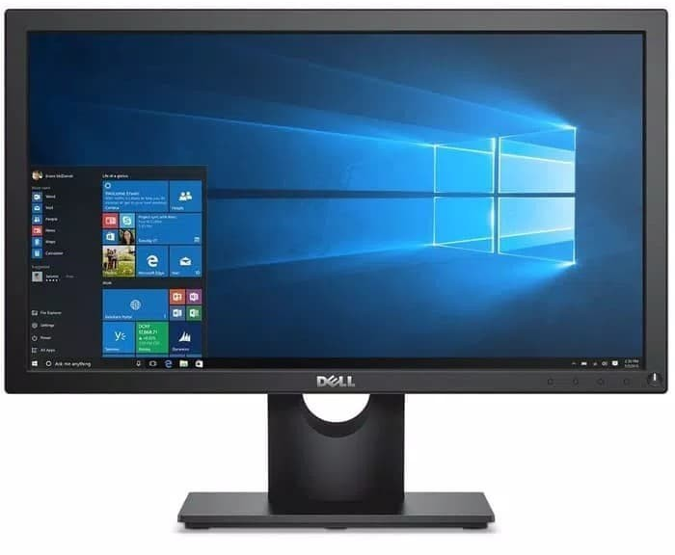
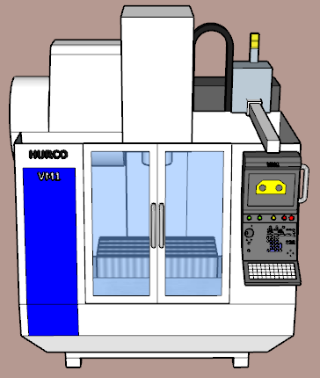

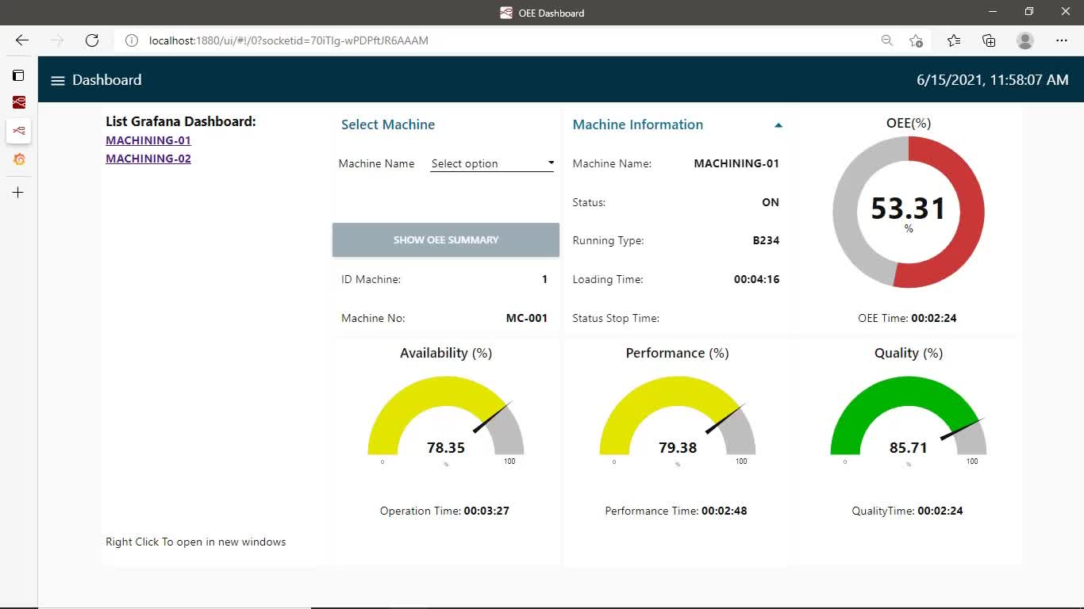
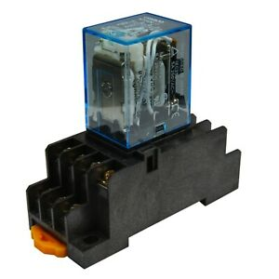
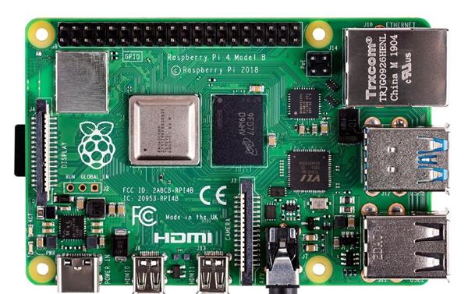
Concept
Database
Dashboard
Machine Relays
Powered by Raspberry Pi
CM 4
Relays
OEE Box

Slide 6
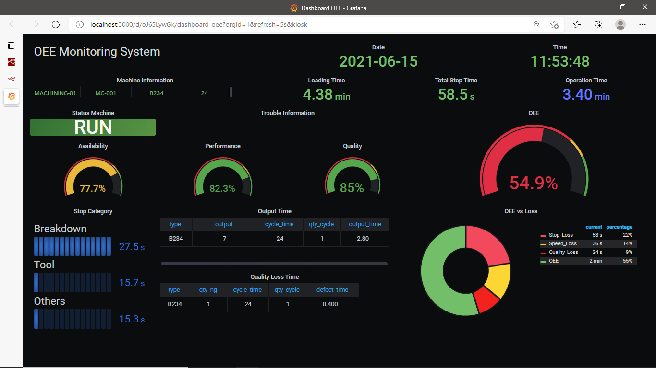
Grafana Dashboard

Slide 7
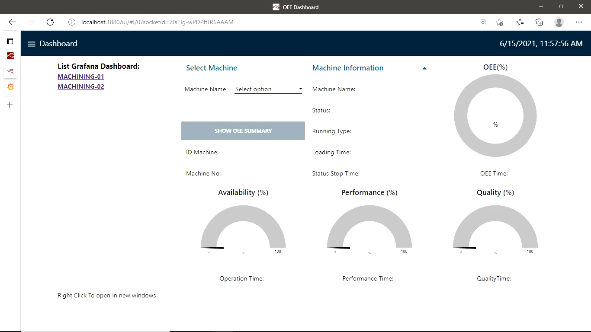
Node-Red Dashboard
Dashboard Real Time
View OEE Real Time
Grafana Access

Slide 8
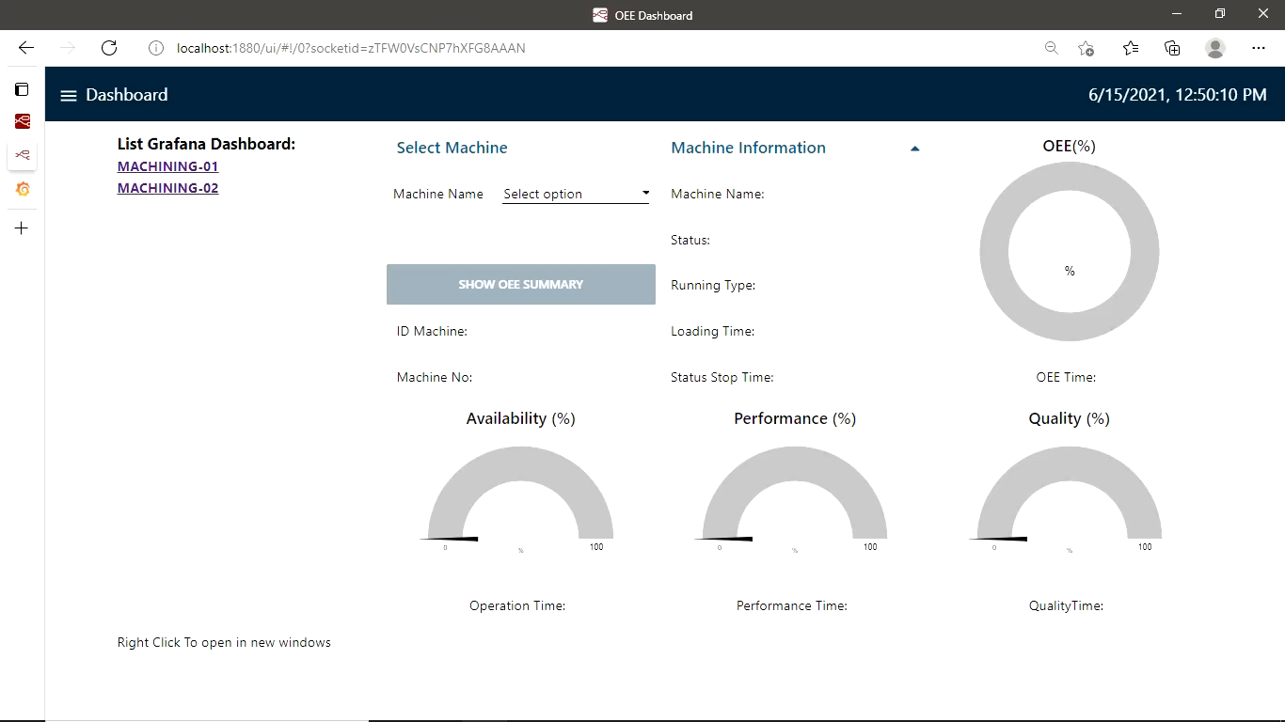
Node-Red Dashboard
Input Type & Stop Category
Input type product / change type
Input current stop time category

Slide 9
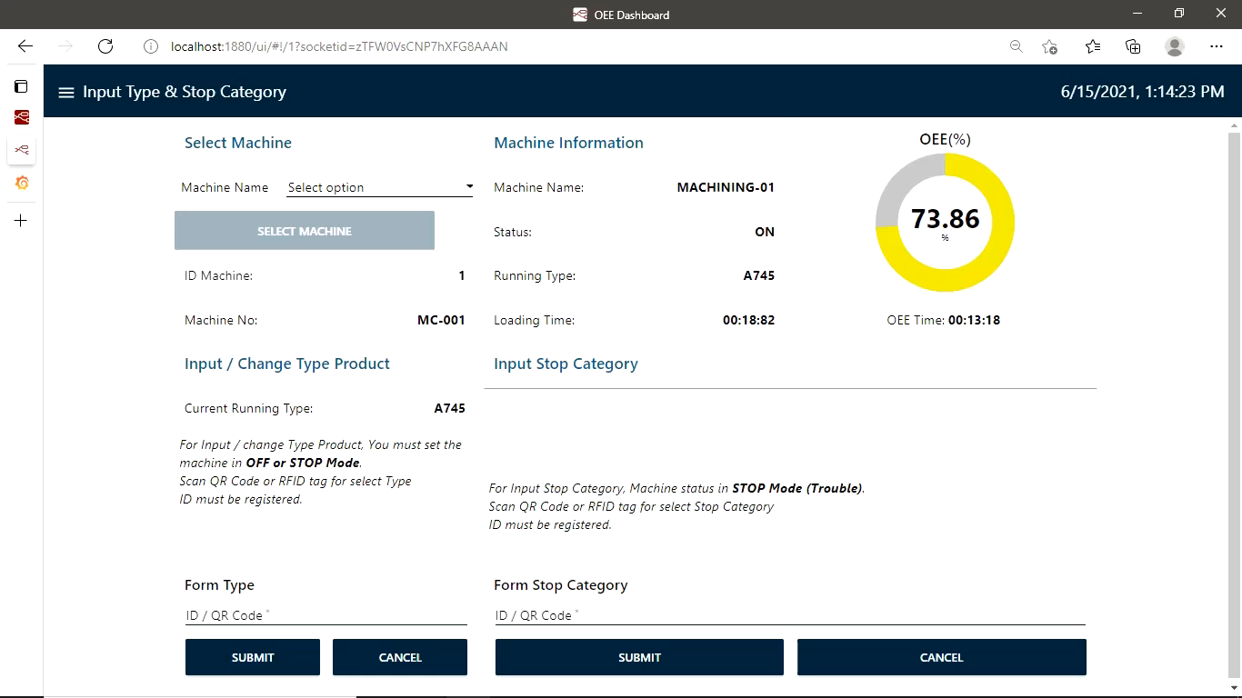
Node-Red Dashboard
Input Defect
Input defect manually
Edit defect

Slide 10
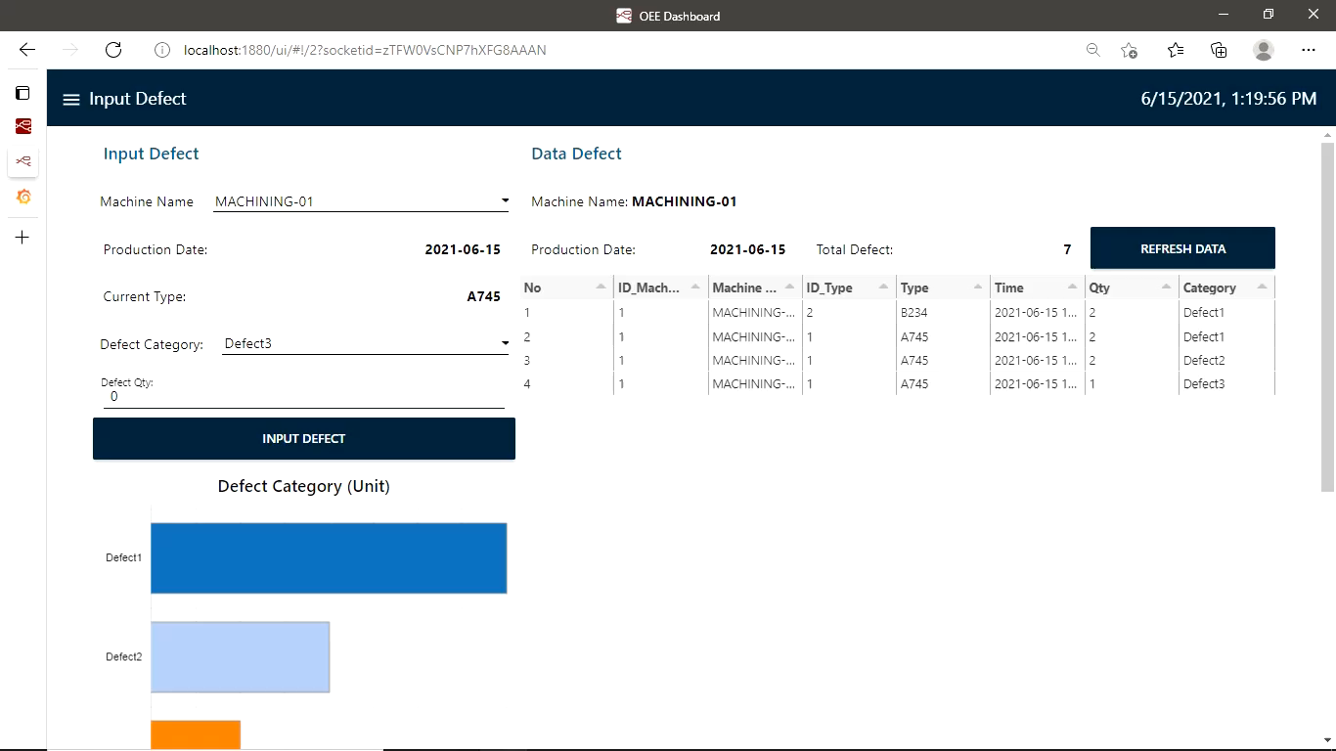
Node-Red Dashboard
Trouble Record
View trouble record
Add comment trouble time

Slide 11
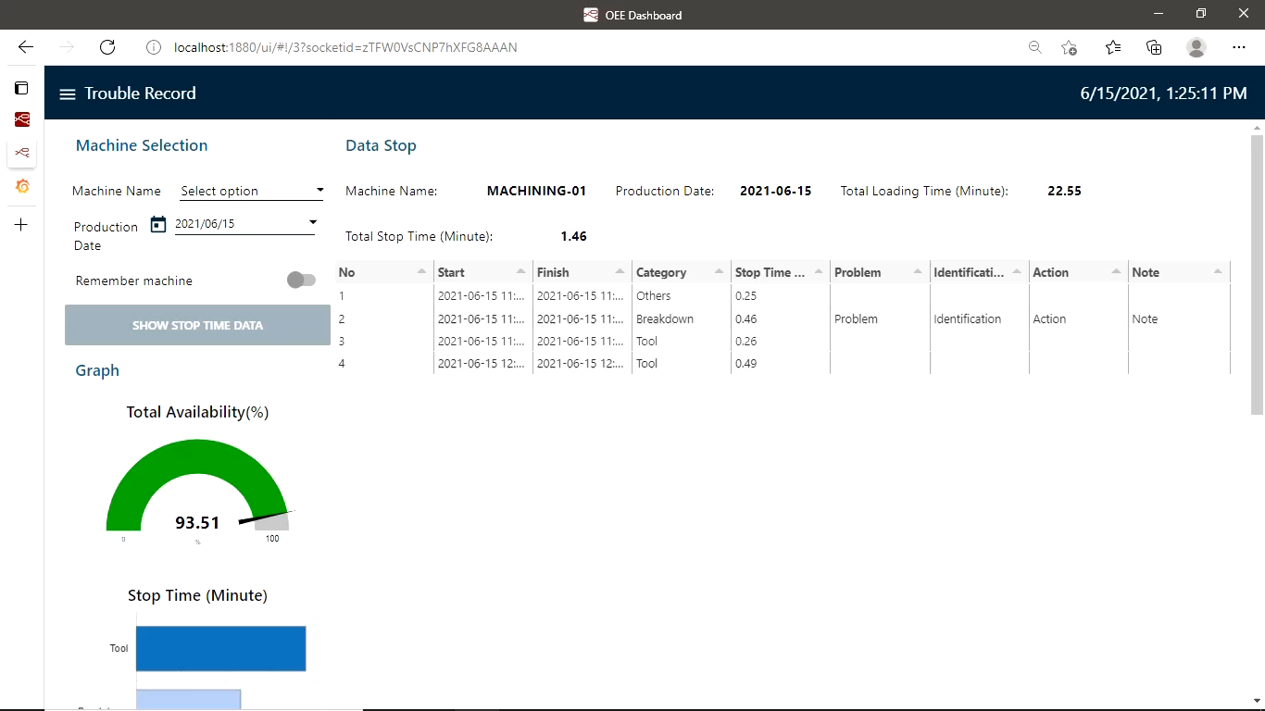
Node-Red Dashboard
OEE Record Date
View OEE based on date

Slide 12
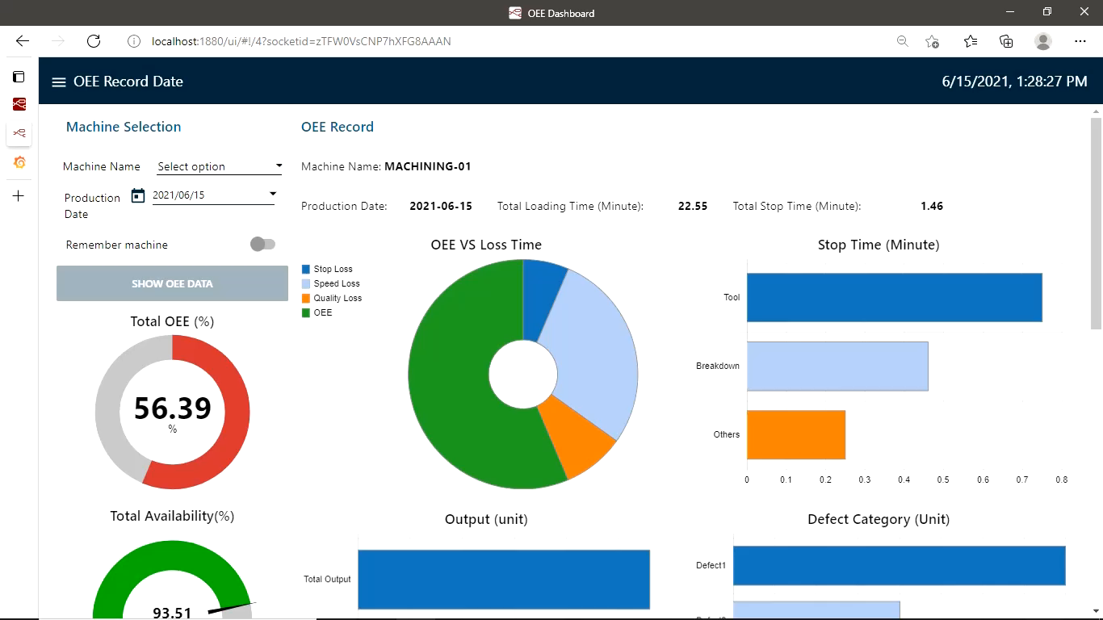
Node-Red Dashboard
Daily OEE Record
View daily OEE and detail information

Slide 13
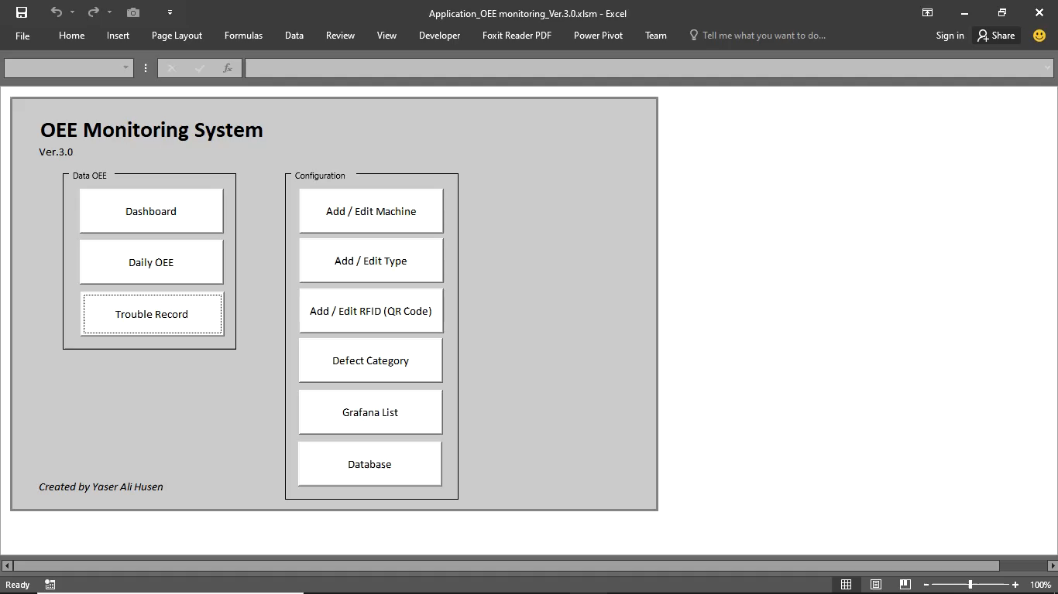
Macro Excel Database Configuration

Slide 14

Thank You
+628128717487

